Slide 1

Chapter 11: Developing a Service Culture
Simon Hudson

Slide 2
Topic Covered
Why service excellence is so critical
Creating a service culture
Converting guests into apostles
Managing service promises
Service recovery

Slide 3
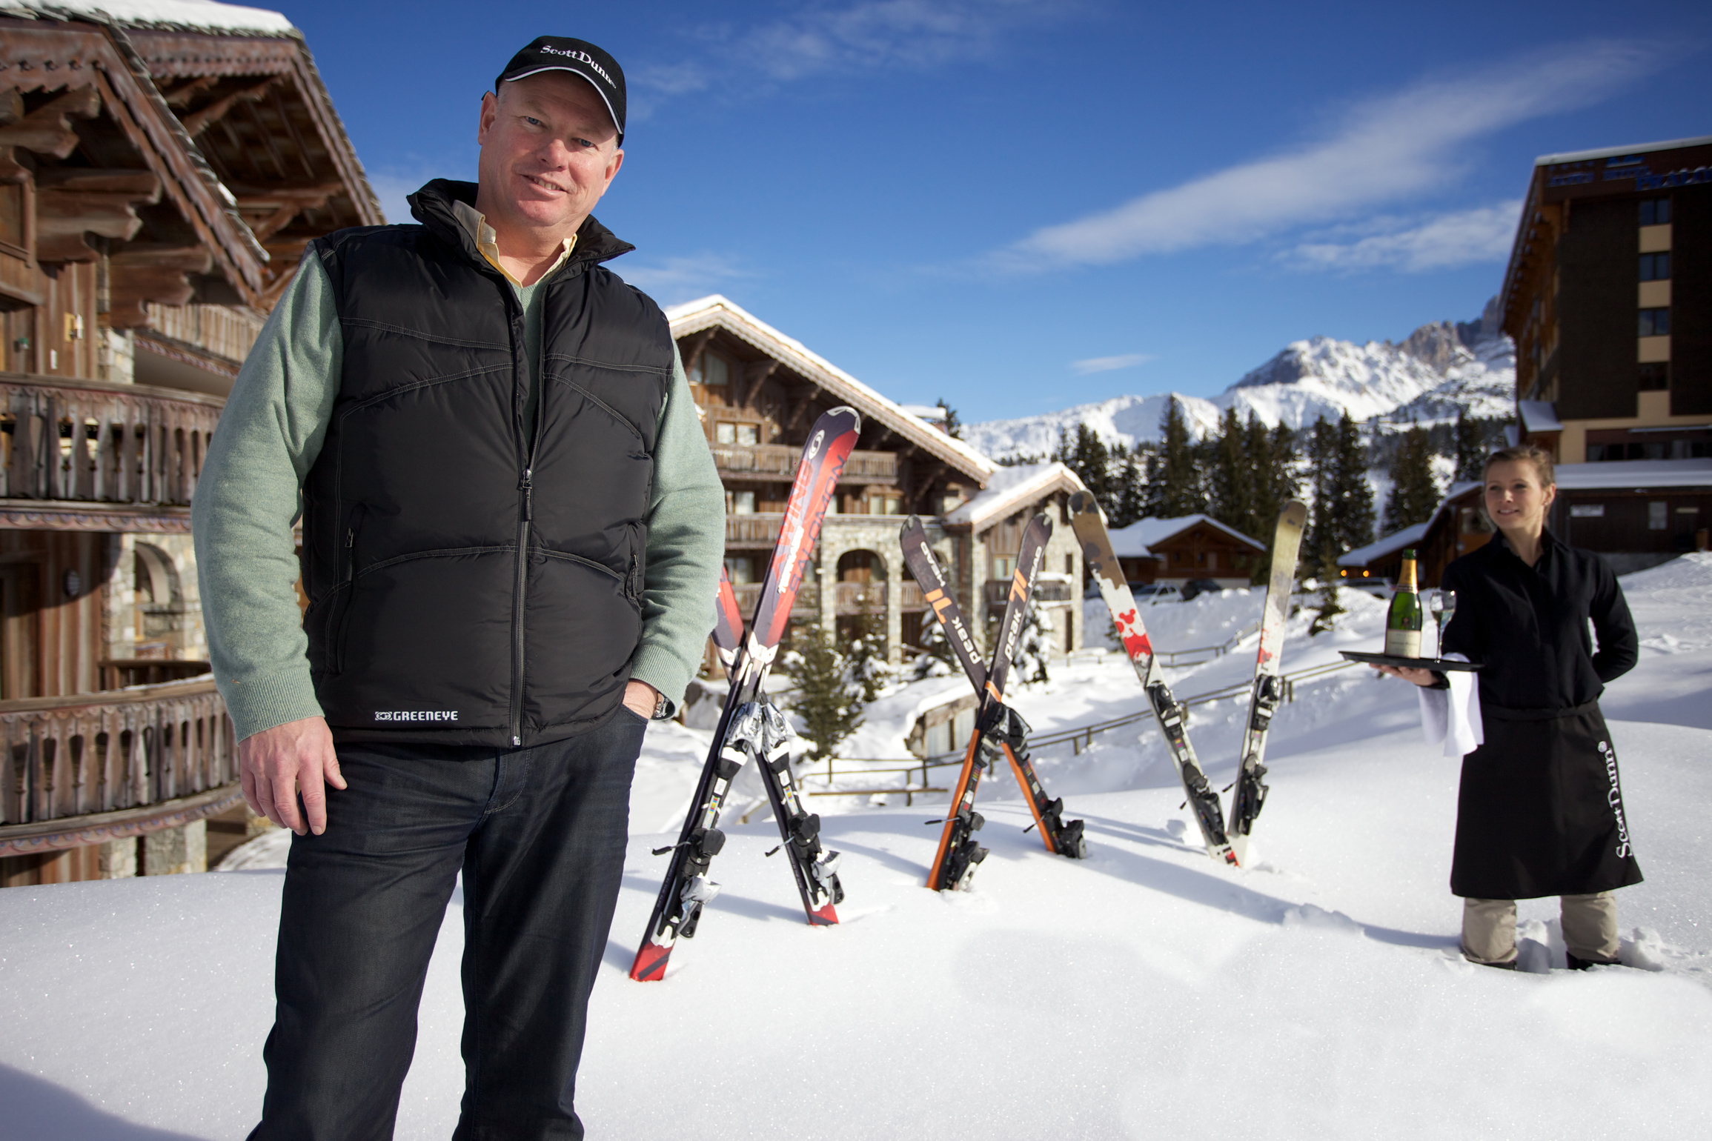
Spotlight
Andrew Dunn: From bacon to beluga
  High-spending clientele is relatively recession-proof
  Focuse on guest loyalty and brand enhancement
  Skiing has changed beyond recognition
  The importance of the family in today’s marketplace

Slide 4
Why service excellence is so critical
Service quality
  reliability, assurance, empathy, responsiveness, and tangibles
  Customer satisfaction
  Spend more on service excellence
  Service profit chain

Slide 5
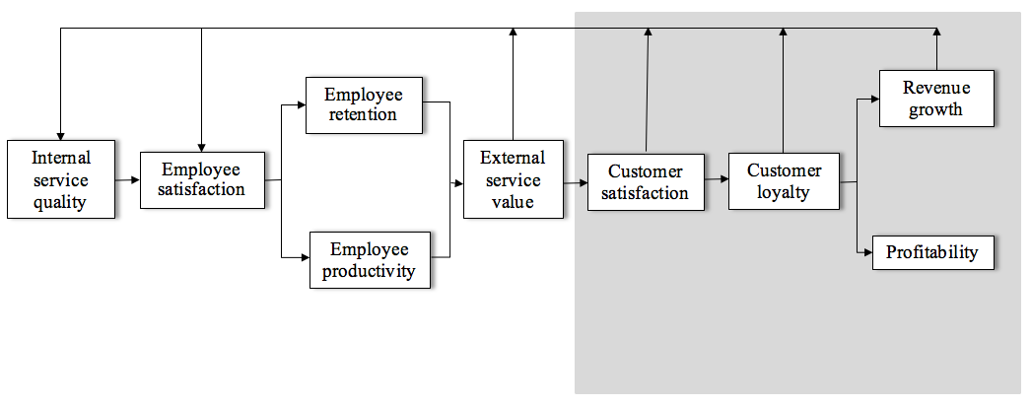
The service profit chain
Source: Adapted from Heskett et al., 1997

Slide 6
Lifetime value of a skier/snowboarder starting at the age of 10
Item | Retail price | Units/Year | Years | Total ($)
Skis | $358 | 0.2 | 35 | $2,506
Boots | $283 | 0.2 | 35 | $1,981
Bindings | $164 | 0.2 | 35 | $1,148
Apparel | $218 | 0.1 | 35 | $763
Accessories | $34 | 1 | 35 | $1,190
Lifts tickets | $71 | 10 | 35 | $24,850
Food/beverage | $34 | 10 | 35 | $11,900
Lodging | $203 | 4 | 35 | $28,420
TOTAL |  |  |  | $72,758
Avg/Year |  |  |  | $2,079
Source: Adapted from Snowsports Industries America, 2012

Slide 7
Creating a service culture
Service culture
  policies, procedures, reward systems, and actions
Service marketing program
Establish a service culture easier in some places
Employees trained based on certain specific standards

Slide 8
Converting guests into apostles
The Apostle Model
  Loyalists: high satisfaction and high loyalty
  Hostages: low satisfaction and high loyalty
  Mercenaries: high satisfaction, but low loyalty
  Defectors: low satisfaction and low loyalty

Slide 9
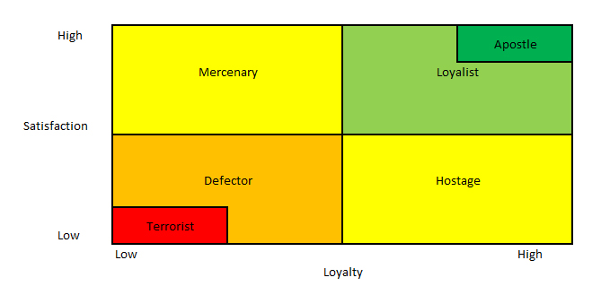
The Apostle Model
Source: Adapted from Jones & Sasser, 1995

Slide 10
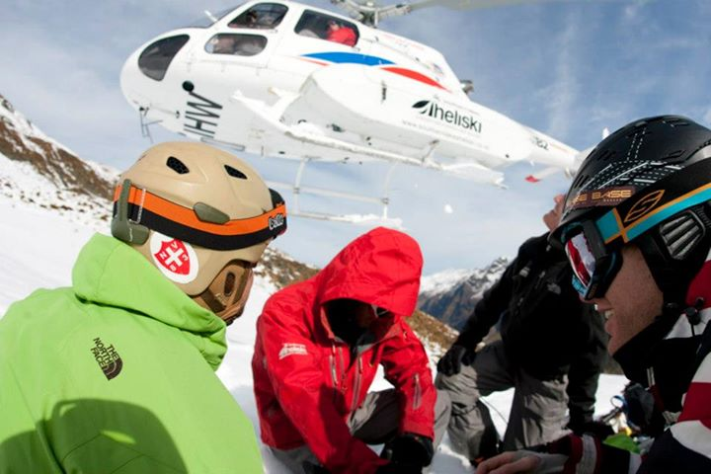
Profile: Customer service ‘Kiwi-style’
Customer service has to be key in heli-skiing operations
Southern Lakes Heliski
  safety and customer satisfaction
  well-trained guides

Slide 11
Managing services promises
Four strategies in managing service promises
Marketing communications tools
  print advertising, websites, sales promotions, public relations, direct marketing and personal selling.
  Realistic promises and communication mechanisms
  Service guarantee

Slide 12
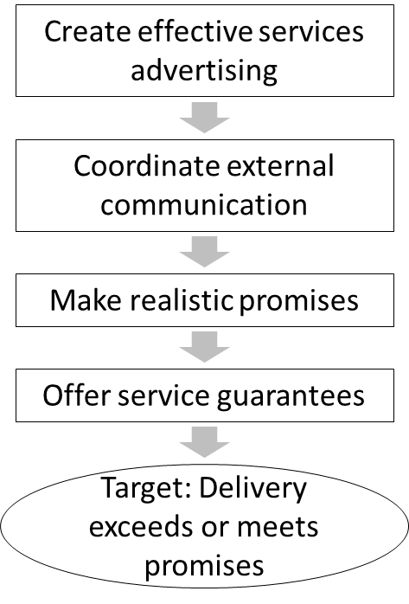
Four strategies that are effective in managing service promises
Source: Adapted from Zeithaml et al., 2007

Slide 13
Service recovery
The service recovery paradox
The service recovery process
  Apology
  Urgent reinstatement
  Empathy
  Symbolic atonement
  Follow-up
  The consequences of an effective recovery process

Slide 14
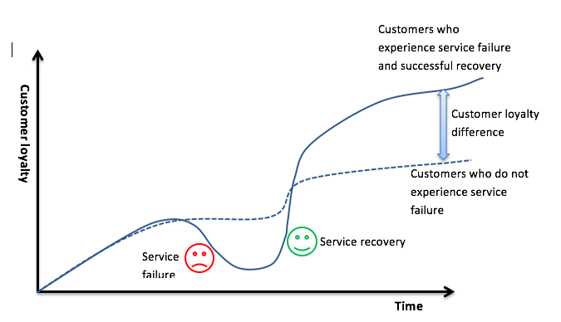
The service recovery paradox
Source: Adapted from Schindlholzer, 2008

Slide 15
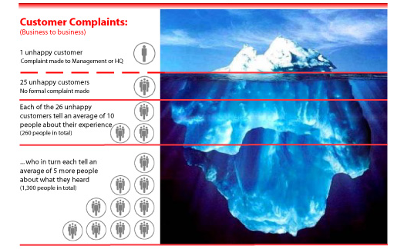
The Customer Complaint Iceberg
Source: Adapted from TARP, 1979

Slide 16

Case study: Customer-centric service at Steamboat Springs
Steamboat
  Western-style, family-friendly atmosphere
  Improving customer service is a trend in ski resorts
  SSRC guidelines

